Slide 1


Framework from Scratch (Quick Look)- Protractor Prepared by: Shrish Tripathi

Slide 2
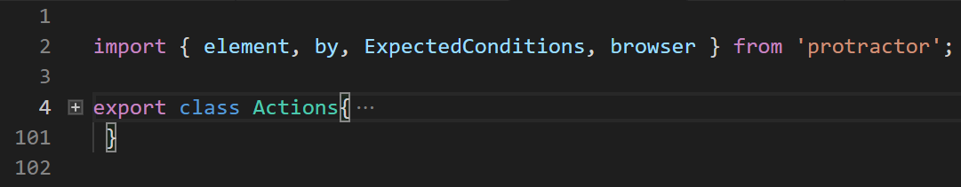
Create Folders for Action( Reusable component) and add all reusable function under class
Create folder for Pages and consume Action(reusable) function and hardcode Xpath and related page action
Create folder for Spec and consume/import all pages and call all function under Describe and it block and declare object .json or data provider
Create folder for Test Data
Create folder for Report/Screenshot
Package.json(Dependency)
Conf.ts (Driver Script)
Webdriver manager
Jasmine
tsconfig.json
node_module(by default)

Slide 3
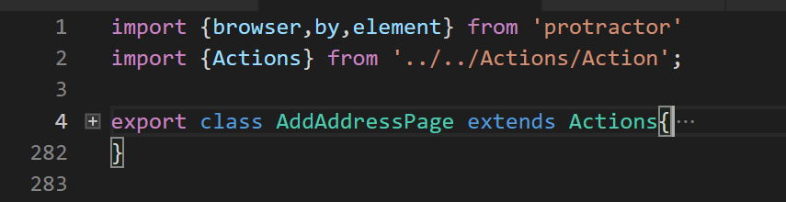
Create Folders for Action( Reusable component)
Create folder for Pages and consume Action(reusable) function and hardcode Xpath and related page action
Create folder for Spec and consume/import all pages and call all function under Describe and it block and declare object .json or data provider
)
Create folder for Test Data
Create folder for Report/Screenshot
Package.json(Dependency)
Conf.ts (Driver Script)
Webdriver manager
Jasmine
tsconfig.json
node_module(by default)

Slide 4
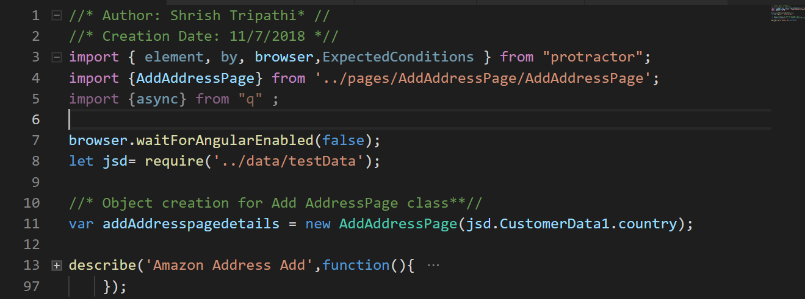
Create Folders for Action( Reusable component)
Create folder for Pages and consume Action(reusable) function and hardcode Xpath and related page action
Create folder for Spec and consume/import all pages and call all function under Describe and it block and declare object .json or data provider
Create folder for Test Data
Create folder for Report/Screenshot
Package.json(Dependency)
Conf.ts (Driver Script)
Webdriver manager
Jasmine
tsconfig.json
node_module(by default)

Slide 5
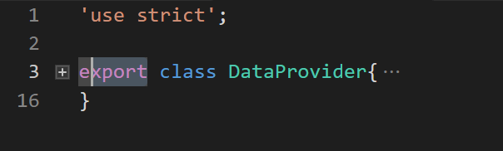
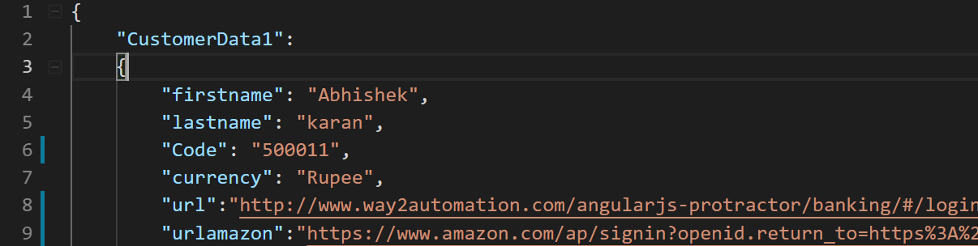
Create Folders for Action( Reusable component)
Create folder for Pages and consume Action(reusable) function and hardcode Xpath and related page action
Create folder for Spec and consume/import all pages and call all function under Describe and it block and declare object .json or data provider
Create folder for Test Data
Create folder for Report/Screenshot
Package.json(Dependency)
Conf.ts (Driver Script)
Webdriver manager
Jasmine
tsconfig.json
node_module(by default)

Slide 6
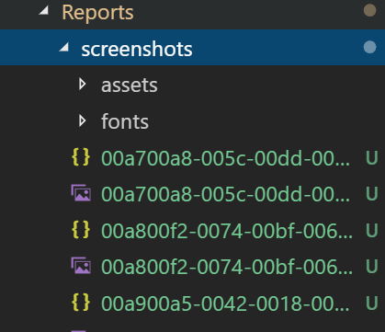
Create Folders for Action( Reusable component)
Create folder for Pages and consume Action(reusable) function and hardcode Xpath and related page action
Create folder for Spec and consume/import all pages and call all function under Describe and it block and declare object .json or data provider
Create folder for Test Data
Create folder for Report/Screenshot
Package.json(Dependency)
Conf.ts (Driver Script)
Webdriver manager
Jasmine
tsconfig.json
node_module(by default)

Slide 7
Thanks

